Slide 1
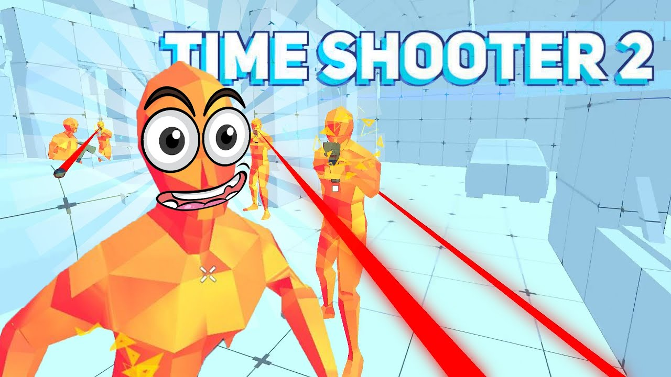

Slide 2
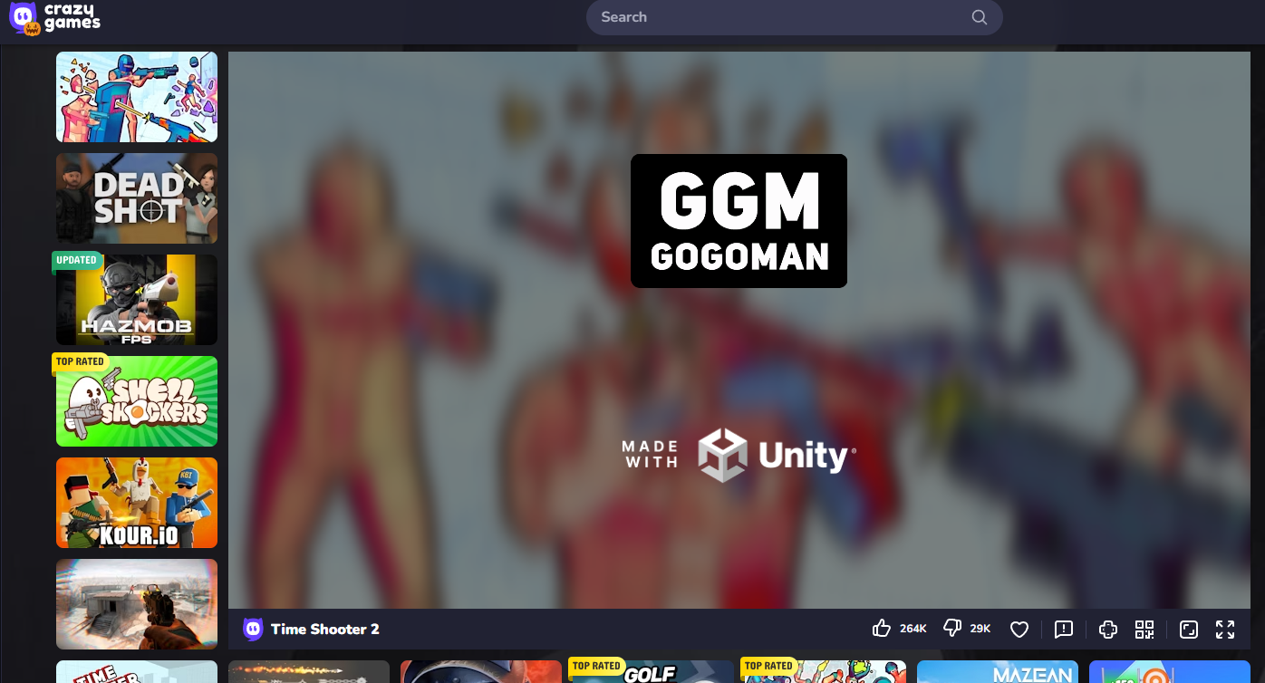
Time Shooter 2
Time Shooter 2 is a first-person shooter game that was made in unity and now playable on the official Crazy Games website. This game allows you to slow down time, tactically avoid bullets, prepare attacks, and outmanoeuvre opponents.

Slide 3
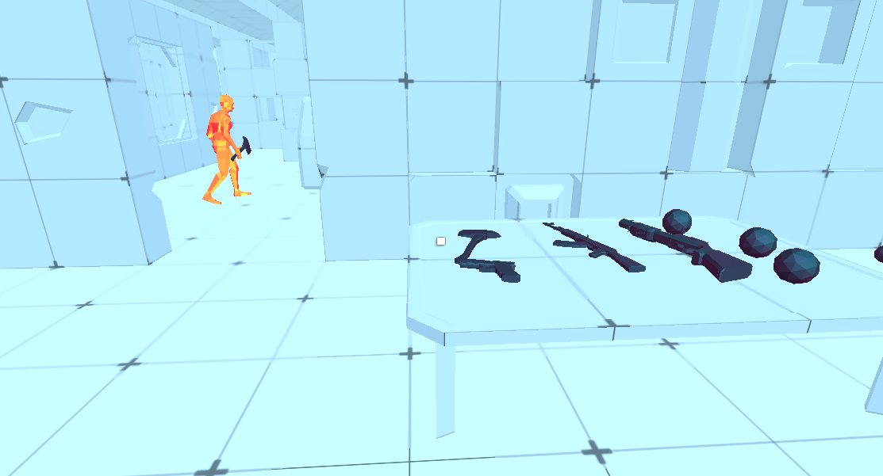
Key Features:
Time Manipulation: The basic concept is that time moves only when you move, allowing you to combine deliberate, systematic preparation with swift action.
Weapons: To take out opponents, you can equip yourself with a variety of weaponry, including guns and melee weapons.
Physics-based Combat: To fight foes, you can use melee attacks, shoot them, or throw objects at them.
Minimalistic Visuals: The game has a distinct style while putting a lot of emphasis on action thanks to its simplistic, low-polygon graphics with colourful adversaries and weaponry.

Slide 4
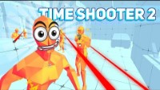
Gameplay

Slide 5
Aim of the game
The gameplay involves progressing through levels by eliminating enemies while taking advantage of the time-slowing mechanic to avoid incoming bullets and attacks. Link to the game - https://www.crazygames.com/game/time-shooter-2

